Slide 1
TeN Mission
Analysis of Vehicle Accident Data
Date: 26 April 2025
Prepared by:
For:
Hector Maldonado
Ten Team

Slide 2
Introduction & Overview
Objective:
To analyze the provided crash datasets (including Primary Person, Units, Charges, Damage , Restrict Endorsements) to answer specific questions regarding accident patterns, participant demographics, vehicle characteristics, contributing factors (like alcohol), geographic distributions, and outcomes (injuries, fatalities, property damage).
Data Set:
Analysis performed using the provided datasets detailing crash incidents. Key tables utilized include Primary Person, Units, Charges, Damages, Endorsements, and Restrict, linked primarily via the CRASH_ID.
Tools Used:
  Primary Analysis: Python (Libraries: Pandas for data manipulation,)
  Development Environment: Visual Studio
  Presentation: [Microsoft PowerPoint

Slide 3
Introduction & Overview
Presentation Outline:
This presentation will cover:
  Analysis 1-7: Findings for each specific question, including methodology, results, and code highlights.
  Analysis 8: Additional insights derived from data exploration.
  Summary: Key takeaways from the analyses.
  Resources: Information on accessing the supporting code.

Slide 4
Business Request
Ten group requires analysis to understand key patterns related to fatalities, vehicle types, demographics, contributing factors (like alcohol use and speeding), geographic locations, and vehicle damage/insurance status.
Solution Overview:
To address the specific analytical requirements, we implemented a data analysis workflow using Python within a Visual Studio Code environment. This approach focuses on directly answering the requested questions through targeted data manipulation, aggregation, and interpretation.

Slide 5
Data Understanding
Technical:
  Schema: Multi-table structure (Primary Person, Units, Charges, etc.) linked primarily by CRASH_ID. Contains identifiers, categorical codes (e.g., PRSN_GNDR_ID, VEH_MAKE_ID), numerical counts (e.g., DEATH_CNT), and descriptive fields.
  Data Quality: Relies on consistent use of IDs across tables. Potential for missing values or varied coding requires validation during analysis (using the dictionary as a guide).
Non-Technical:
  Purpose: Provides comprehensive details on vehicle crashes to analyze causes, involved parties, vehicle types, locations (driver ZIP), contributing factors (alcohol, charges), and outcomes (injuries, damage).
  Scope: Captures person-level details (demographics, injury severity), vehicle specifics (make, type, damage scale), location indicators, and official actions (charges).
  This structured approach enables pattern recognition, risk assessment, and data-driven safety improvements

Slide 6
Data Understanding
Key Preparation Steps:
Data Loading: Loaded datasets (Charges, Damages, etc.) from CSVs into Pandas DataFrames (Python). Implemented error handling and used low_memory=False for Units.csv.
Initial Exploration: Checked DataFrame shapes (.shape) and performed preliminary inspection of structure/types (.info(), .head()).
Missing Value Analysis: Calculated and reviewed the percentage of null values per column (.isnull().sum()).
Duplicate Verification & Removal: Checked for duplicate rows based on logical keys (.duplicated()). Identified and removed duplicate entries in charges_df, damages_df, and units_df to ensure data integrity, keeping the first occurrence (.drop_duplicates(keep='first')).
Merging Strategy: Merges planned on-demand per analysis requirement using cleaned data.

Slide 7
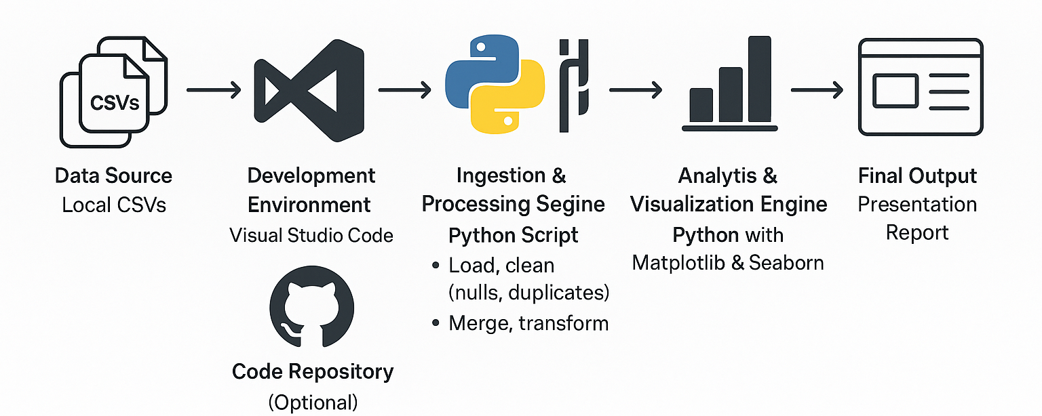
Data Analysis Flowchart with Python

Slide 8
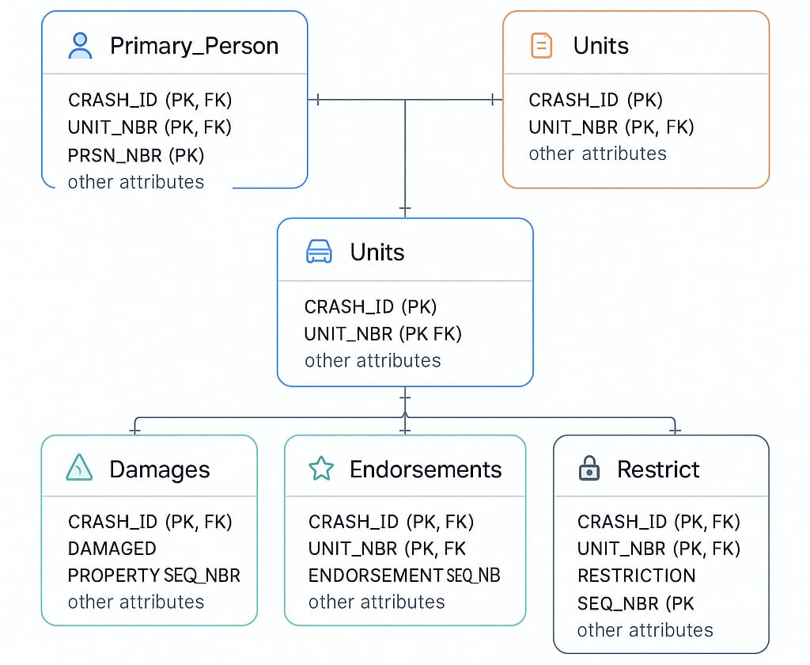
Crash Dataset ERD
Charges

Slide 9

Analysis

Slide 10
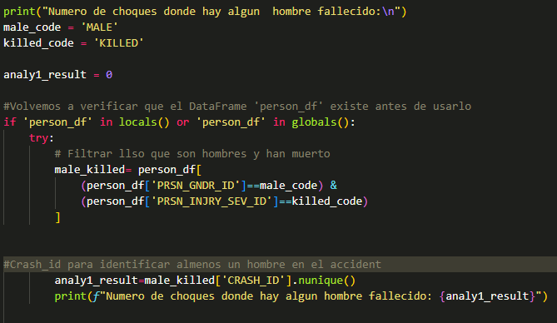
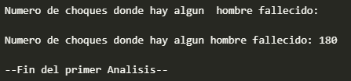
Analysis 1 - Crashes with Male Fatalities
Question:
Find the number of crashes (accidents) in which number of persons killed are male?
Methodology:
  Identify Data: Used the person_df table which contains individual details including injury severity and gender, linked by CRASH_ID.
  Identify Fields: Focused on CRASH_ID, PRSN_INJRY_SEV_ID (Injury Severity), and PRSN_GNDR_ID (Gender).
  Define Filters:
    Filtered person_df for records where PRSN_INJRY_SEV_ID equals 'Killed’
    Filtered person_df for records where PRSN_GNDR_ID equals the code representing 'Male’
  Combine & Select
  Unique Crashes: Extracted the unique CRASH_ID values from the filtered results. This ensures we count each crash only once, even if multiple males were killed in the same crash.
  Count: Calculated the total count of these unique CRASH_IDs.

Slide 11
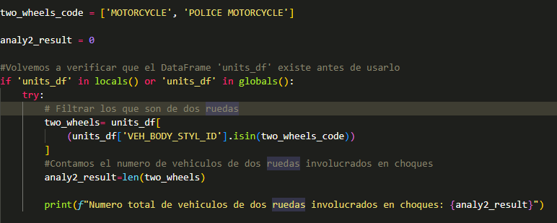
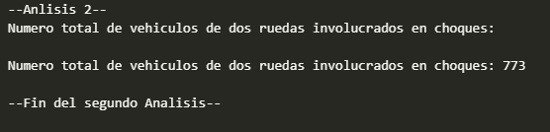
Analysis 2 - Two-Wheeler Involvement in Crashes?
Question:
How many two-wheelers are booked for crashes?
Assumed "booked for crashes" means "involved in reported crashes“:
Identified "two-wheelers" based on the VEH_BODY_STYL_ID column in units_df.
Methodology:
  Identify Data: Used the units_df (Units) table.
  Identify Field: Focused on the VEH_BODY_STYL_ID column.
  Define Filter: Created a list of specific two-wheeler codes: ['MOTORCYCLE', 'POLICE MOTORCYCLE'].
  Apply Filter
  Count: Calculated the total number of rows in the filtered DataFrame.a

Slide 12
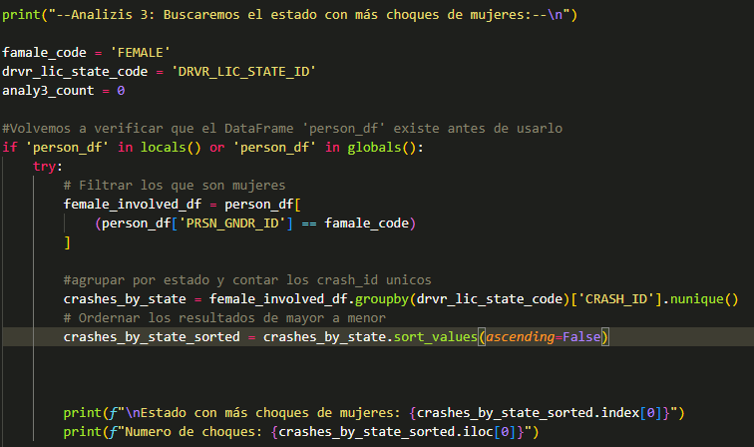
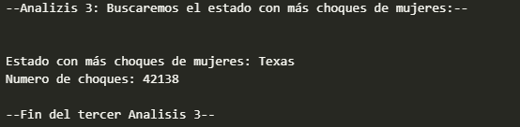
Analysis 3 - State with Most Female-Involved Crashes
Question:
Which state has the highest number of accidents in which females are involved?
The dataset provides DRVR_LIC_STATE_ID (Driver License State) but not the Crash Location State. Therefore, the analysis was adapted to find the most frequent Driver License State among female persons involved in crashes
Methodology:
Identify Data: Used person_df table.
Identify Fields: Focused on PRSN_GNDR_ID and DRVR_LIC_STATE_ID.
Define Filter: Filtered person_df for records where PRSN_GNDR_ID equals 'FEMALE'.
Group & Count: Performed a value_counts() on the DRVR_LIC_STATE_ID column of the filtered (female-only) DataFrame. This counts how many times each driver license state appears for females involved in crashes.
Find Maximum: Identified the state with the highest count from the results.

Slide 13
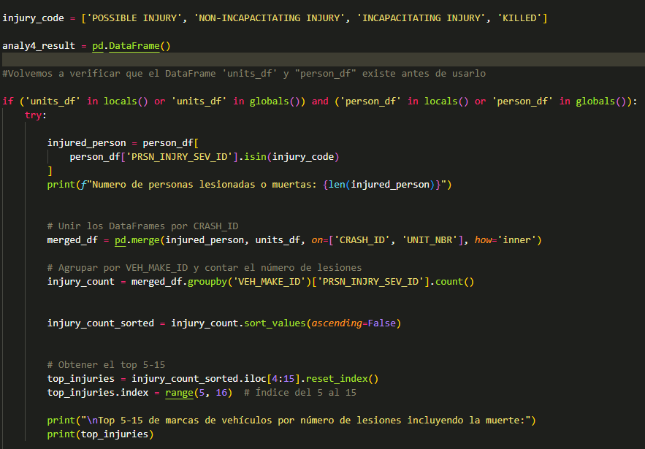
Analysis 4 - Top 5th-15th Vehicle Makes by Injuries & Deaths
Question:
Which are the Top 5th to 15th VEH_MAKE_IDs that contribute to the largest number of injuries including death?
This was interpreted as finding the vehicle makes associated with the highest number of injuries.
Methodology:
  Identify Data: Used person_df (for injury/gender) and units_df (for vehicle make).
  Identify Fields: Focused on PRSN_INJRY_SEV_ID (person_df), VEH_MAKE_ID (units_df), and the linking keys CRASH_ID, UNIT_NBR.
  Define Filter: Created a list of injury/fatality codes:
  Merge Data: Inner merge between the filtered injured_person_df and units_df on CRASH_ID and UNIT_NBR
  Group & Count: Grouped the merged DataFrame by VEH_MAKE_ID.
  Sort: Sorted the resulting counts in descending order.
  Select Ranks: Extracted the vehicle makes and counts corresponding to the 5th through 15th ranks

Slide 14
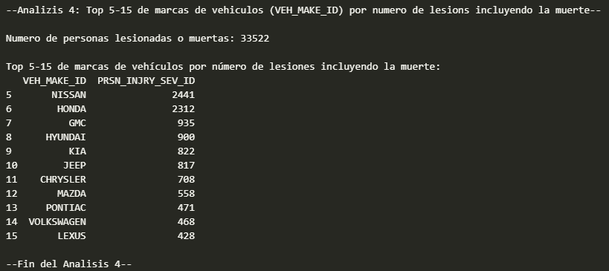
Analysis 4 Result:
Finding:
The following table shows the vehicle makes ranked 5th through 15th based on the total number of associated persons who were reported as injured (Possible Injury, Non-incapacitating, Incapacitating) or killed in crashes:

Slide 15
Analysis 5 - Top 5 Driver ZIP Codes for Alcohol-Related Crashes
Question:
Among the crashed cars, what are the Top 5 Zip Codes with the highest number of crashes with alcohol as the contributing factor to a crash (Use Driver Zip Code)?
"Alcohol as the contributing factor" means identifying units where CONTRIB_FACTR_1_ID or CONTRIB_FACTR_2_ID (from units_df) corresponds to an alcohol-related code
Methodology:
Identify Data: Used units_df and person_df.
Define Filters:
  Alcohol Factor Codes: ['UNDER INFLUENCE - ALCOHOL', 'HAD BEEN DRINKING']
  Driver Person Code: 'DRIVER' (Assumed - Verify)
Filter Units: Selected units where matched the alcohol codes.
Filter Persons: Selected persons identified as the driver.
Merge Data: Merged units and persons on CRASH_ID and UNIT_NBR.
Clean ZIP Codes: Removed rows with missing DRVR_ZIP values using dropna().
Group & Count Unique Crashes: Grouped by DRVR_ZIP and counted unique CRASH_IDs.
Sort & Select Top 5: Sorted counts descending and selected the top 5 ZIP codes.

Slide 16
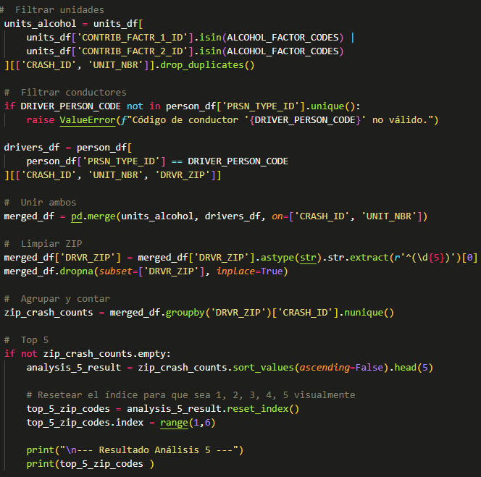
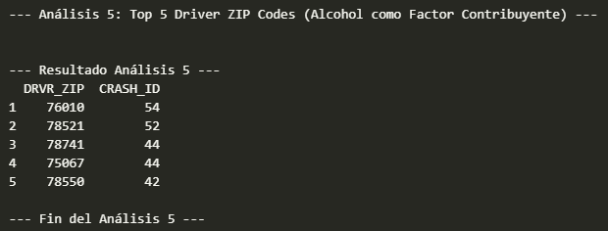
Analysis 5 - Result
Finding:
The following table show the Top 5 Driver Zip Codes associate with the highest number of accidents where alcohol was listed as a factor. These ZIPs are suspiciously close to each other– maybe party districts?

Slide 17
Analysis 6 - Crashes with Specific Level Damage & Insurance Criteria
Request:
Count of Distinct Crash IDs where No Damaged Property was observed, and Damage Level (VEH_DMAG_SCL~) is above 4 and car avails Insurance.
Methodology:
Identify Crashes with NO Property Damage:
  Created a set of all unique CRASH_IDs from units_df (all_crashes).
  Created a set of unique CRASH_IDs present in damages_df (crashes_with_property_damage).
  Calculated the difference: crashes_no_property_damage = all_crashes - crashes_with_property_damage.
Identify Units Meeting Damage & Financial Responsibility Criteria:
  Defined high damage levels: ['DAMAGED 5', 'DAMAGED 6', 'DAMAGED 7 HIGHEST'].
  Defined all financial responsibility codes (excluding NaN).
  Filtered units_df where (VEH_DMAG_SCL_1_ID is in high damage list OR VEH_DMAG_SCL_2_ID is in high damage list) AND (FIN_RESP_TYPE_ID is in the financial responsibility list).
  Extracted the unique CRASH_IDs from these filtered units into a set (high_damage_fin_resp_set).
Find Intersection: Found the CRASH_IDs present in both the crashes_no_property_damage set AND the high_damage_fin_resp_set.
Count Distinct IDs: Counted the number of unique CRASH_IDs in the final intersection set.

Slide 18
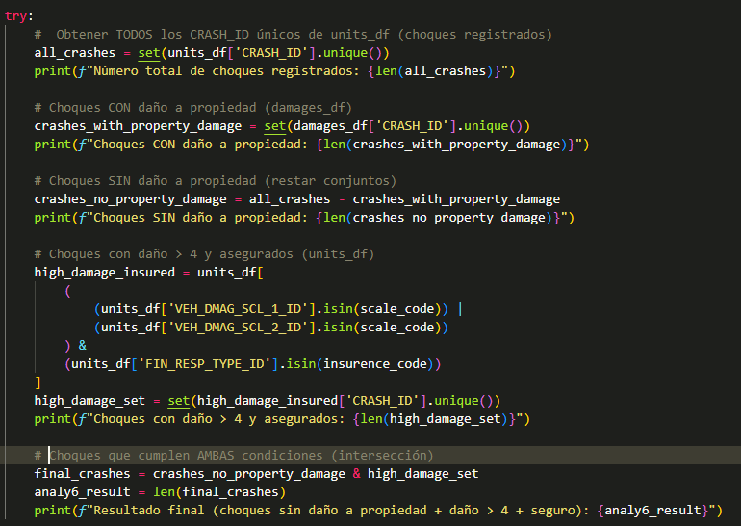
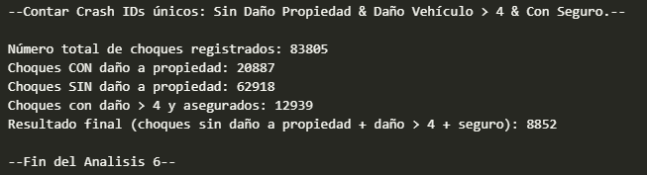
Analysis 6 - Result
Finding:
The analysis identified 8852 distinct Crash IDs that simultaneously meet all the criteria:

Slide 19
Analysis 7 -Methodology for Top 5 Vehicle Makes (Complex Criteria)
Request:
Determine the Top 5 Vehicle Makes where drivers are charged with speeding related offences, have licensed Drivers, use top 10 used vehicle colours, and have car licensed with the Top 25 states with highest number of offences (to be deduced from the data).
Methodology:
Part 1: Determine Filtering Lists (Sub-Analyses)
Identify Speeding Offences:
  Explore unique values in charges_df['CHARGE'].
  Create a list (speeding_charge_codes) containing all codes/strings clearly indicating a speeding-related offence
  Identify Licensed Drivers andExplore unique values in person_df['DRVR_LIC_STAT_ID'].
  Create a list (valid_license_codes) and Also need the code for person_df['PRSN_TYPE_ID'] representing the 'DRIVER'.
Identify Top 10 Vehicle Colors
Identify Top 25 States by Offences:
  Merge charges_df with units_df on CRASH_ID and UNIT_NBR (to link charges to the vehicle's licensed state).
  Group the merged result by VEH_LIC_STATE_ID. And Count the total number of charges associated with each state.
  Sort states by charge count (descending) and select the Top 25 state IDs/codes.
Part 2: Apply Filters & Rank Make
Merge Data
Apply Combined Filters: Filter the merged DataFrame to keep only rows where all following conditions are true:
* CHARGE is in speeding_charge_codes.
* PRSN_TYPE_ID equals the 'DRIVER' code.
* DRVR_LIC_STAT_ID is in valid_license_codes.
* VEH_COLOR_ID is in top_10_color_ids.
* VEH_LIC_STATE_ID is in top_25_state_ids.
Group by Make & Count:
Select Top 5: Sort the counts descending and identify the Top 5 VEH_MAKE_IDs.

Slide 20
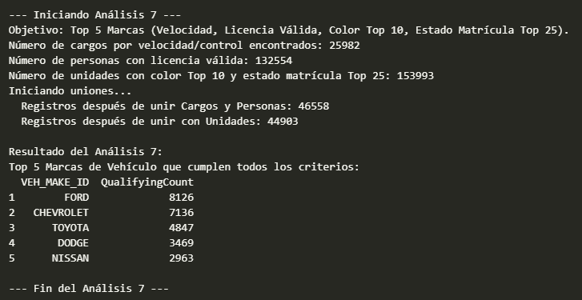
Analysis 7 - Results
Finding:
The following table shows the Top 5 Vehicle Makes associated with incidents meeting all specified criteria:
Driver charged with Speeding or Failure to Control Speed.
Driver held a valid license status.
Vehicle color was among the Top 10 most common colors.
Vehicle was licensed in one of the Top 25 states with the highest overall offence counts.

Slide 21
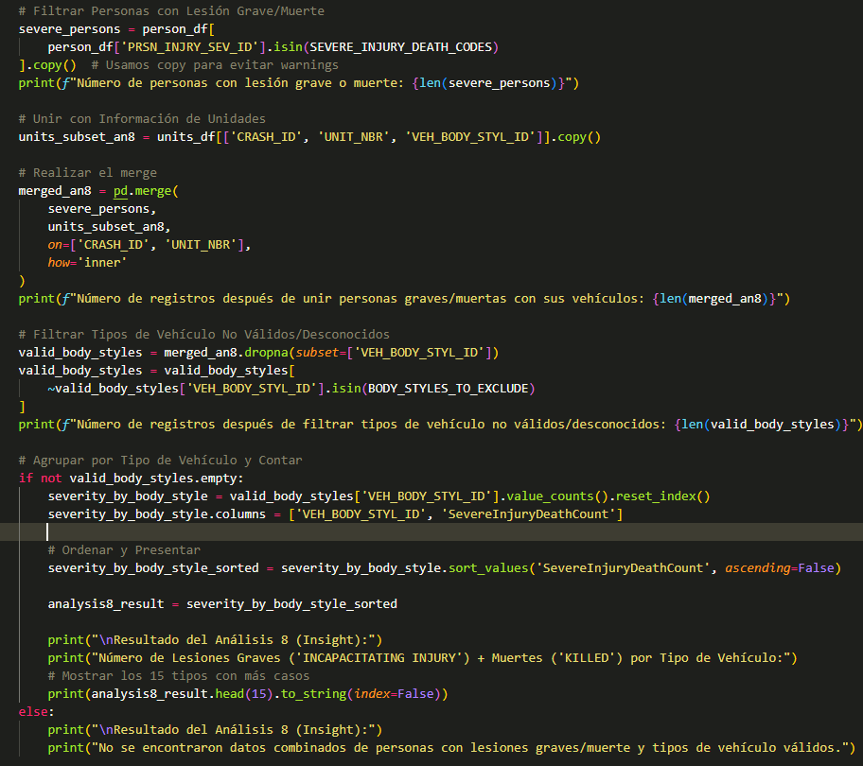
Analysis 8 - Severe Injuries/Fatalities by Vehicle Type
Request:
Any other insights that you can share based on the data provided.
Identify if certain vehicle body styles are disproportionately associated with more severe crash outcomes (incapacitating injuries or fatalities) to inform potential safety awareness campaigns
Methodology:
Filtered person_df to select individuals with PRSN_INJRY_SEV_ID as 'INCAPACITATING INJURY' or 'KILLED'. (Found 2920 persons).
Merged this subset with units_df on CRASH_ID and UNIT_NBR. (Resulted in 3000 records).
Excluded records where VEH_BODY_STYL_ID was missing or non-specific ('UNKNOWN', 'OTHER', 'NOT REPORTED'). (Left 2755 records).
Grouped the results by VEH_BODY_STYL_ID.
Counted the number of severe injury/death occurrences associated with each body style.
Sorted the results to identify the top body styles.

Slide 22
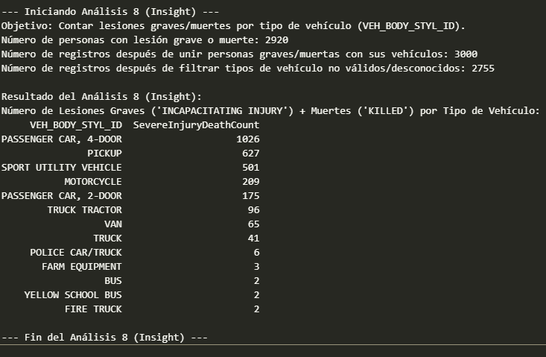
Analysis 8 - Results
Findings:
The raw counts show Passenger Cars (4-door), Pickups, and SUVs associated with the most severe injuries/fatalities. However, this is likely influenced by the high number of these vehicle types involved in crashes overall.
While Motorcycles rank 4th in absolute counts (209 occurrences), intuition suggests their risk per crash might be significantly higher due to lack of protection. The current analysis (based on counts alone) doesn't confirm this relative risk.
Next Step Recommendation: To understand the true relative risk, further analysis is needed to calculate the rate of severe injury/death per vehicle

Slide 23
Resumen y Conclusiones Clave
Este análisis da respuestas específicas a las preguntas planteadas y descubrió patrones adicionales en los datos de choques:
Análisis 1 (Fatalidades Masculinas): Se identificaron 180 choques únicos con al menos una fatalidad masculina registrada.
Análisis 2 (Dos Ruedas): Un total de 784 unidades identificadas como 'MOTORCYCLE' o 'POLICE MOTORCYCLE' estuvieron involucradas en choques.
Análisis 3 (Choques con Mujeres - Adaptado): Debido a la falta de datos de ubicación del choque, se encontró que el estado de licencia de conducir Texas fue el más asociado (42,138 choques únicos) con incidentes donde mujeres estuvieron involucradas.
Análisis 4 (Marcas 5ta-15ta por Lesionados): Las marcas NISSAN (2441 personas) y HONDA (2312 personas) lideraron el grupo clasificado entre el 5to y 15vo lugar por número de personas lesionadas/fallecidas asociadas.
Análisis 5 (Top ZIPs Alcohol): El código postal de conductor 76010 (54 choques únicos) encabezó la lista de los 5 principales asociados con choques donde el alcohol fue citado como factor contribuyente.
Análisis 6 (Criterios Específicos): Se identificaron 8852 choques únicos que cumplían simultáneamente: sin daño a propiedad registrado, con daño vehicular mayor al nivel 4, y con prueba de responsabilidad financiera asociada a la unidad dañada.
Análisis 7 (Criterios Complejos): FORD (8126 ocurrencias) y CHEVROLET (7136 ocurrencias) fueron las principales marcas de vehículos vinculadas a conductores con cargos por velocidad, licencia válida, colores populares (Top 10) y matrículas de estados con alta incidencia de ofensas (Top 25).
Análisis 8 (Tipo Vehículo vs Severidad): Los Autos de Pasajeros (4 puertas) registraron el mayor número absoluto de personas con lesiones graves/muertes asociadas (1026), seguidos por Pickups (627) y SUVs (501). Sin embargo, el recuento para Motocicletas (209) sugiere una necesidad de analizar las tasas para evaluar el riesgo relativo.

Slide 24
Código y Recursos
Código Fuente:
  El código completo en Python (Jupyter Notebook) utilizado para este análisis, incluyendo la carga de datos, limpieza, exploración y todos los análisis específicos (Análisis 1-8), está disponible:
    En el siguiente repositorio de GitHub: https://github.com/HyonaBadguy/Ten-Mission.git
Datos:
  Análisis realizado de los archivos CSV proporcionados: Charges.csv, Damages.csv, , Restrict.csv, Units.csv, Endorse.csv, Primary_Person.csv.
Herramientas Principales Utilizadas:
  Lenguaje/Librerías: Python (Pandas)
  Entorno de Desarrollo (IDE): Visual Studio Code
  Presentación: Microsoft PowerPoint
Quedo a disposición para cualquier consulta o para discutir en mayor profundidad los hallazgos y la metodología aplicada.

Slide 25
Thank You

